Slide 1
Machine Learning
Lecture 04
Robert Kissell, PhD
Robert.L.Kissell@gmail.com

Slide 2
Outline
Tonight, 11/17
Summary of Semester to Date
Review of HW#2, HW#3
Machine Learning
Assignment, HW #4
Next Lectures:
11/21, Portfolio Optimization #5
12/1, Algorithmic Trading #6
12/8, Non-Linear Optimization, Sampling, Sensitivity Analysis #7
Final Project: Portfolio Optimization

Slide 3
Machine Learning
Machine Learning
Neural Networks
Applications & Software
Examples:
Handwriting, Visual, & Speech Recognition
Sector & Bond Classification
Sports Prediction Revisited

Slide 4
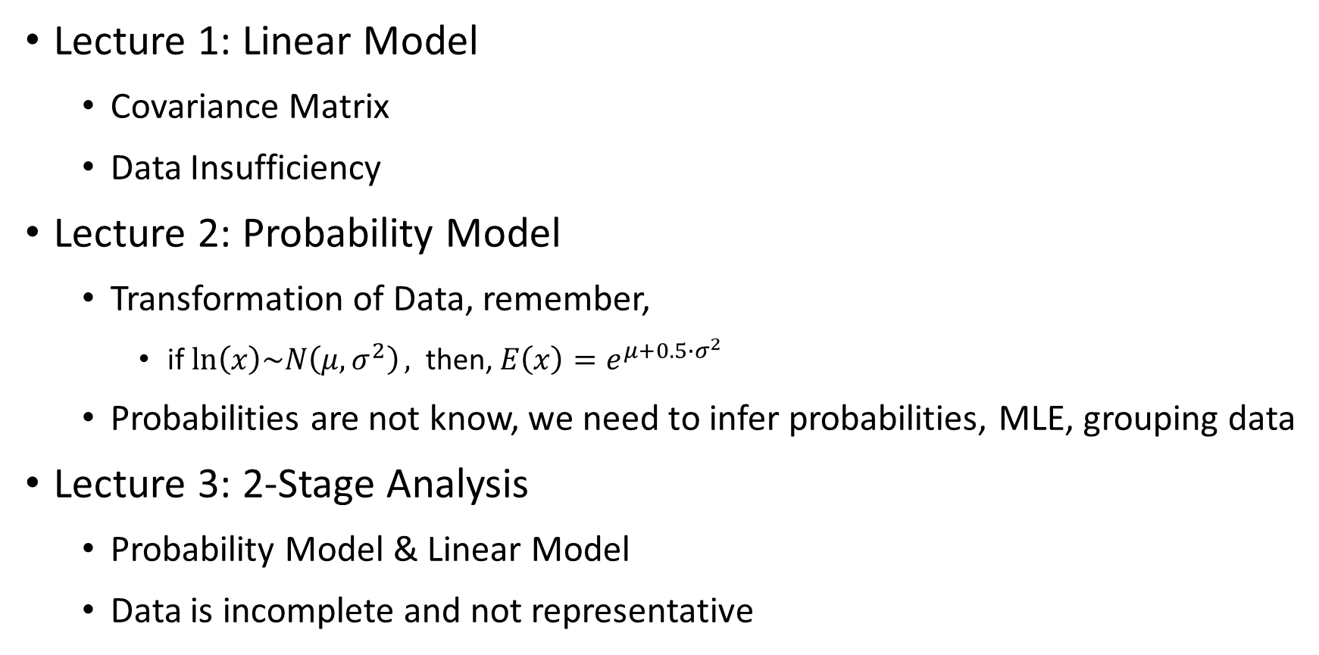
Review
Lecture 1: Linear Model
Covariance Matrix
Data Insufficiency
Lecture 2: Probability Model
Transformation of Data, remember,
if $\ln\left(x\right)\sim N\left(μ,σ^{2}\right),$ then, $E\left(x\right)=e^{μ+0.5∙σ^{2}}$
Probabilities are not know, we need to infer probabilities, MLE, grouping data
Lecture 3: 2-Stage Analysis
Probability Model & Linear Model
Data is incomplete and not representative

Slide 5
What is Machine Learning?

Slide 6
Machine Learning
Machine learning is a subfield of computer science that evolved from the study of pattern recognition and computational learning theory in artificial intelligence.
Machine Learning gives computers the ability to learn without being explicitly programmed (Arthur Samuel, 1959).
Machine Learning Algorithms:
Neural Networks, Genetic Algorithms, Artificial Intelligence, Cluster Analysis, Decision Trees, Classification, Pattern Recognition
Machine learning algorithms are often categorized supervised or unsupervised.
Supervised algorithms require input and output data, and a defined measure of accuracy of the predictions during training.
Unsupervised algorithms only require input data. This is based on an iterative approach called “deep learning” to review data and arrive at conclusions.
Unsupervised learning algorithms are used for more complex processing tasks than supervised learning systems.

Slide 7
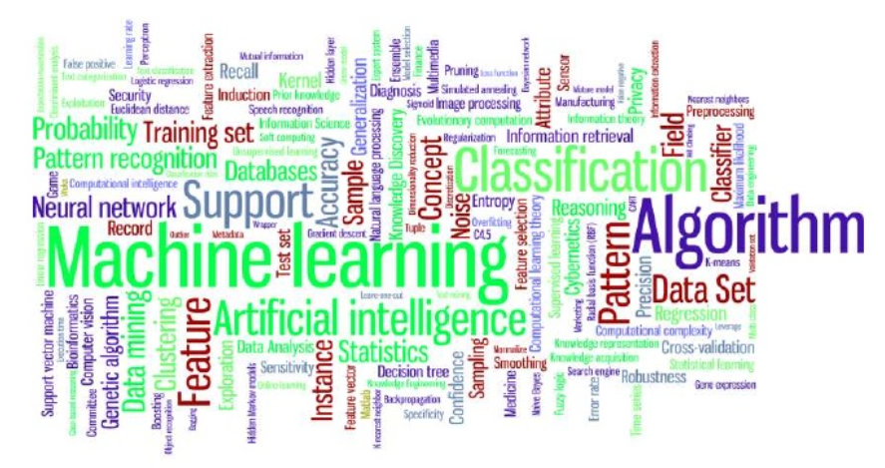
Machine Learning
Source: https://www.slideshare.net/liorrokach/introduction-to-machine-learning-13809045

Slide 8
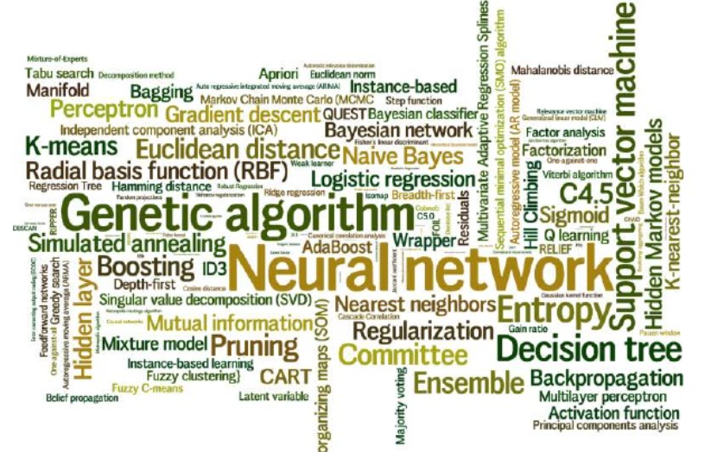
Machine Learning Algorithms
Source: https://www.slideshare.net/liorrokach/introduction-to-machine-learning-13809045

Slide 9
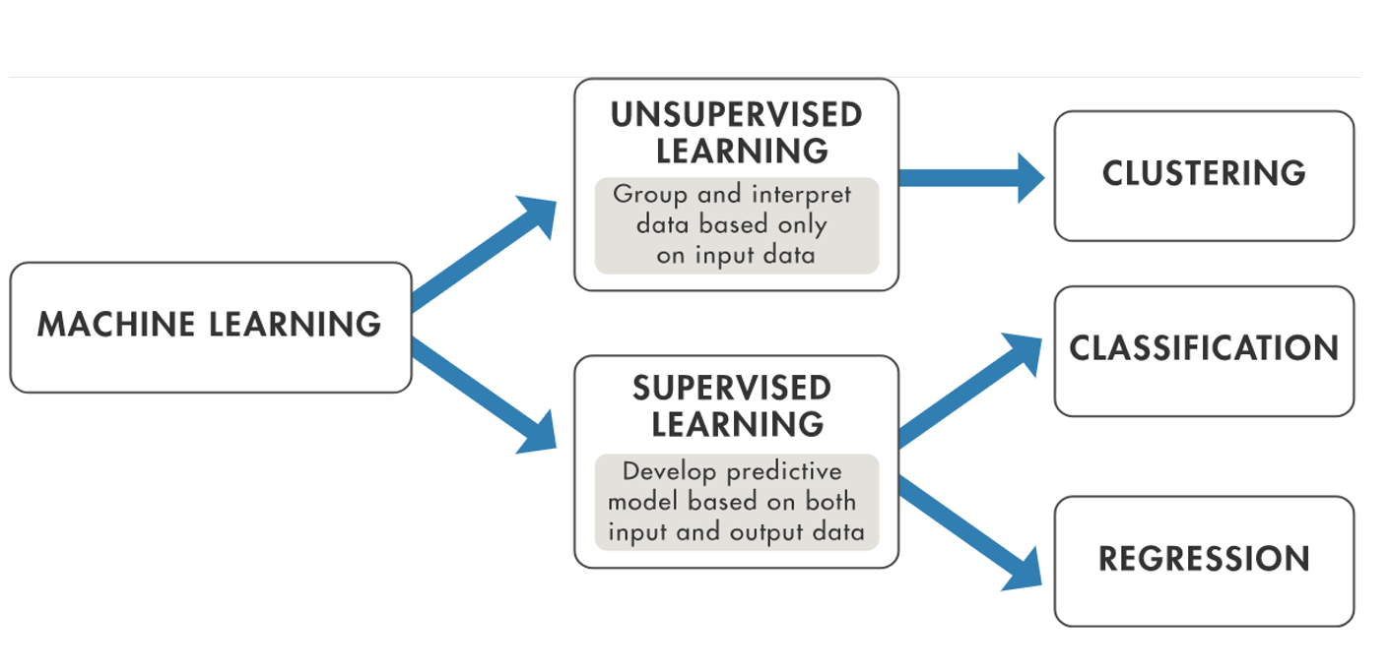

Machine Learning
Source: MATLAB 2017 Quantitative Finance Conference

Slide 10
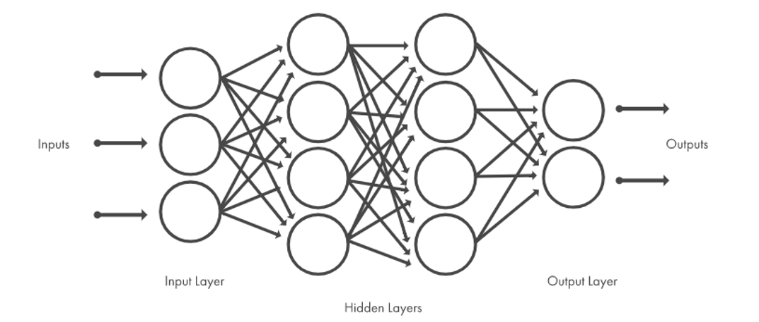
Machine Learning using Neural Networks
Source: MATLAB 2017 Quantitative Finance Conference

Slide 11
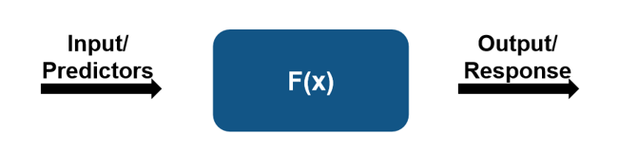
Machine Learning Applications in Finance
Source: MATLAB 2017 Quantitative Finance Conference

Slide 12
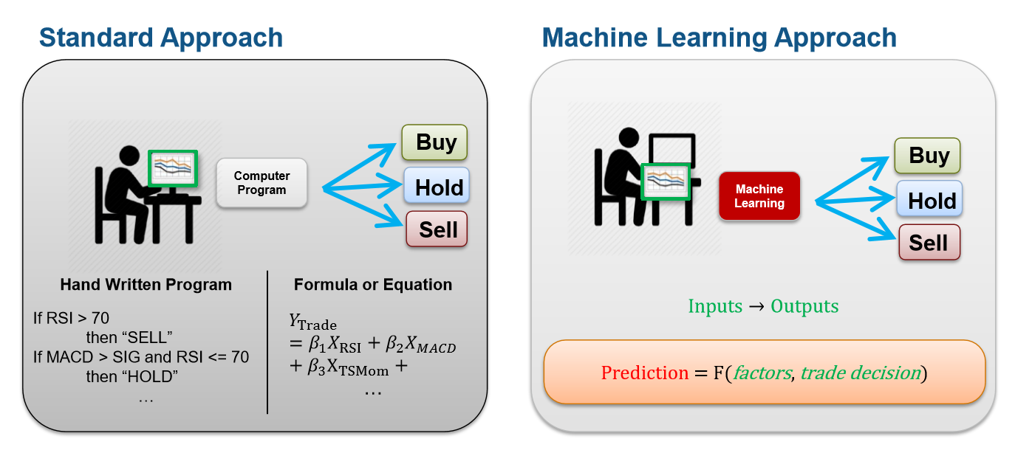
Machine Learning
Source: MATLAB 2017 Quantitative Finance Conference

Slide 13
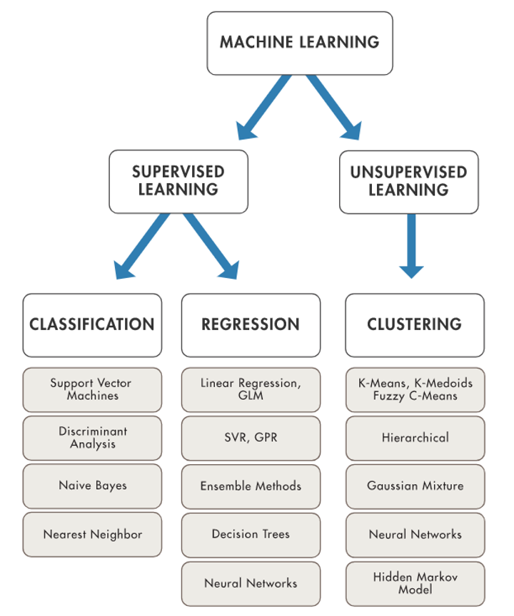
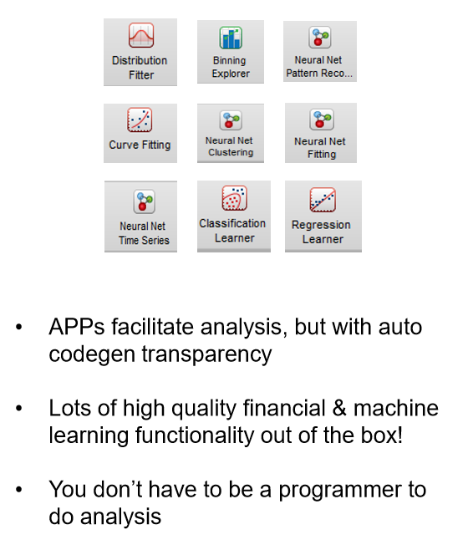
Machine Learning in MATLAB
Source: MATLAB 2017 Quantitative Finance Conference

Slide 14
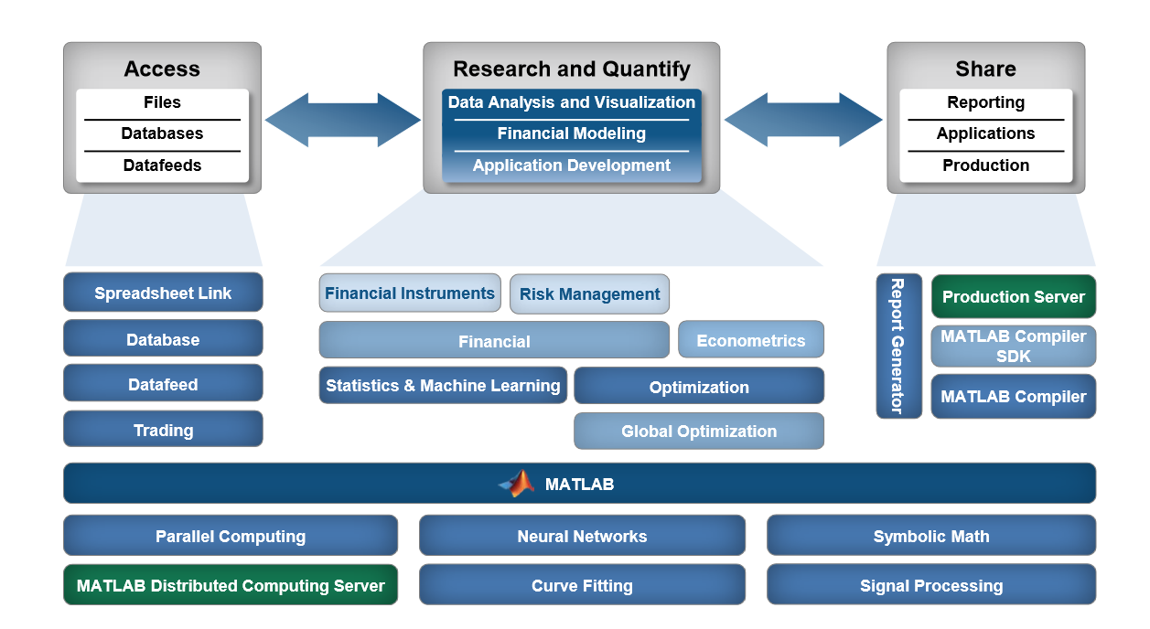
Machine Learning Workflow in MATLAB
Source: MATLAB 2017 Quantitative Finance Conference

Slide 15
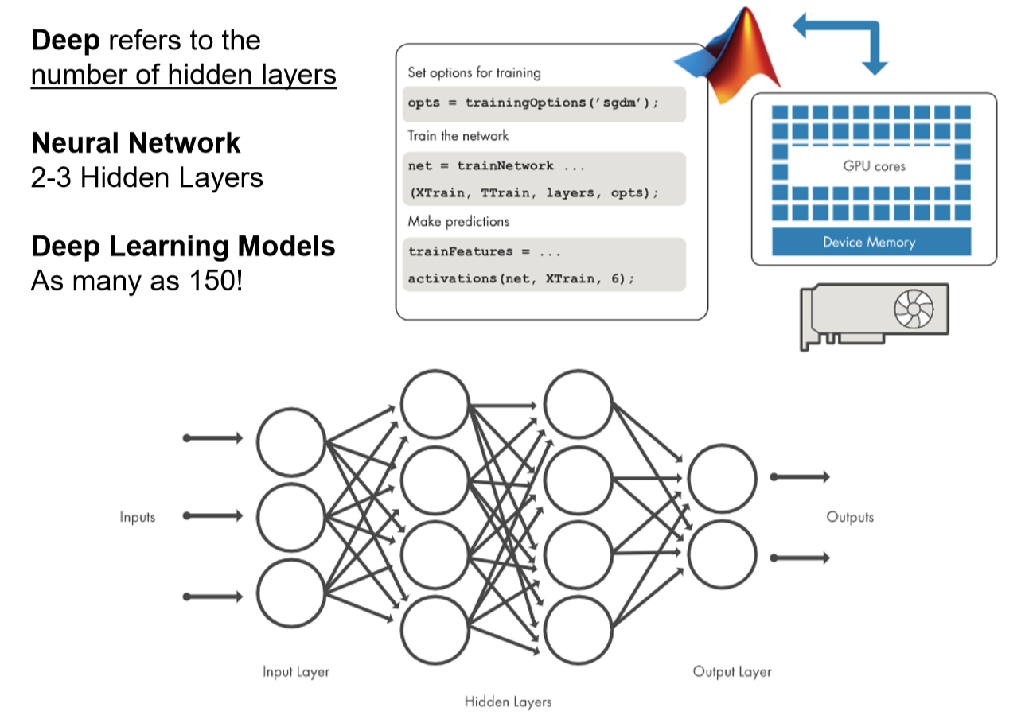
Deep Learning is Available in MATLAB
Source: MATLAB 2017 Quantitative Finance Conference

Slide 16
Machine Learning Challenges:
Data Challenges:
Volume of data is growing
Velocity of data is accelerating
Variety of data is dynamic
Data cleaning is time consuming
Modeling Challenges:
Data driven models
No “one-size” fits all solution
Machine learning is iterative
Production Challenges:
Scalability – leveraging IT resources
Flexibility – interfacing with systems

Slide 17
Examples

Slide 18
Handwriting / Facial / Voice Recognition

Slide 19
The T-C Problem
T
C
How do we train a computer to recognize our handwriting and to distinguish between the letters T and C?
Source: Simulating Neural Networks with Mathematica, James Freeman

Slide 20
The T-C Problem
C
C
C
C

Slide 21
The T-C Problem
T
T
T
T

Slide 22
The T-C Problem
T
T
C
C
T
T
C
C

Slide 23
Vectorize a Data Grid
Data Grid
Vector Locations

Slide 24
Data Vectors

Slide 25
Letter Vector Set

Slide 26
Letter “T” Data Vector Set

Slide 27
Letter “C” Data Vector Set

Slide 28
The T-C Neural Network Layout

Slide 29
NNET - Machine Learning
Input Data is entered as Column Vectors
Output Data is entered as Column Vectors
Analysts define the number of nodes, hidden layers, and transfer functions
Additional Machine Learning Algorithms can be used to determine the most appropriate number of nodes, layers, and transfer functions.

Slide 30
NNET - Machine Learning Training Vectors

Slide 31
Machine Learning - Trained Network

Slide 32
Machine Learning – NNet Prediction

Slide 33
Machine Learning – NNet Prediction

Slide 34
Machine Learning with Increased Precision & Accuracy
Smaller Grid – Less Precision & Accuracy – Less Data
Larger Grid – Less Precision & Accuracy – Less Data
3 x 3 = 9
30 x 30 = 900

Slide 35
Classification / Cluster Analysis

Slide 36
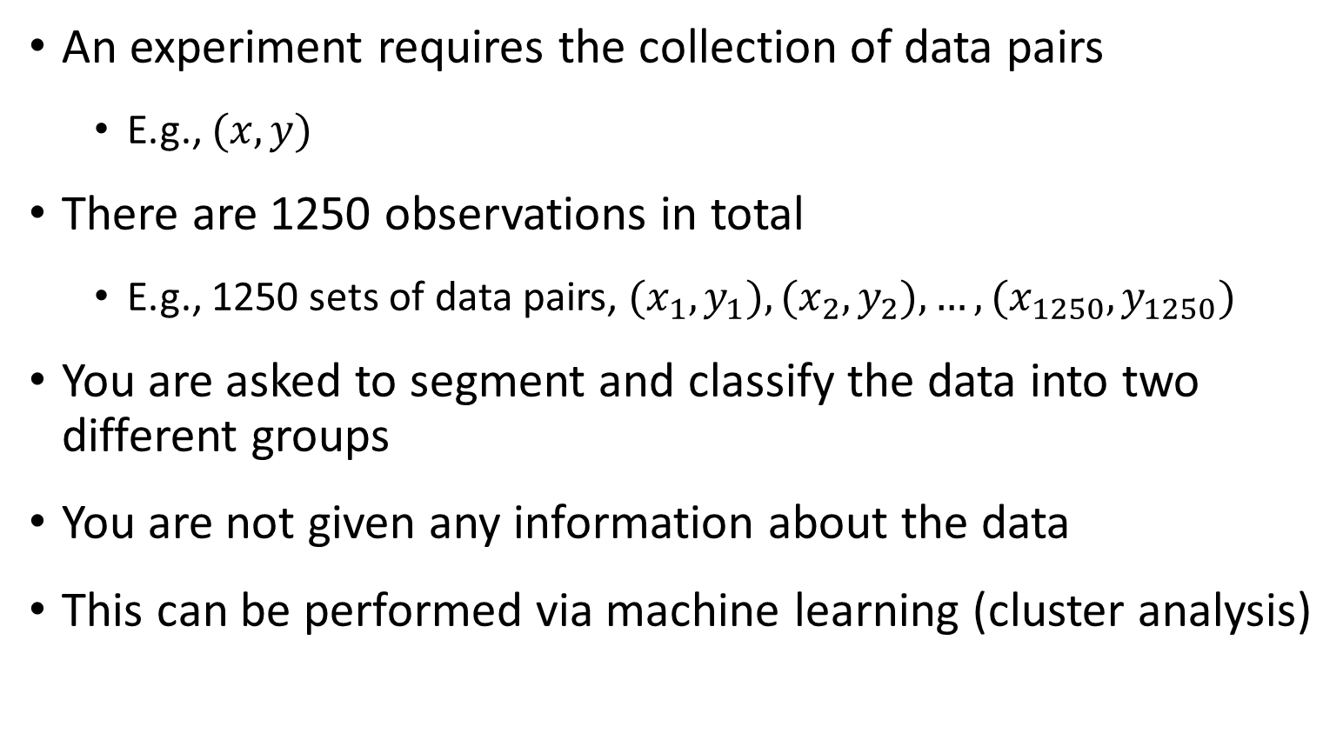
Machine Learning – Cluster Analysis
An experiment requires the collection of data pairs
E.g., $(x,y)$
There are 1250 observations in total
E.g., 1250 sets of data pairs, $(x_{1}, y_{1}), (x_{2}, y_{2}),…, (x_{1250},y_{1250})$
You are asked to segment and classify the data into two different groups
You are not given any information about the data
This can be performed via machine learning (cluster analysis)

Slide 37
Classification / Cluster Analysis
1250 Pairs of Data are plotted on the graph above
The first 25 pairs of Data are shown in the table on the right

Slide 38
Classification / Cluster Analysis
Category A
Category B

Slide 39
Classification / Cluster Analysis

Slide 40
Classification / Cluster Analysis

Slide 41
Cluster Analysis
Cluster Analysis will determine the best way to segment the data pairs.
Analysts will specify the number of desired segments.
The machine learning algorithm will determine the best center positions for each data category group.
E.g., In MATLAB,
[IDX, C] = kmeans(X, P)
returns the K cluster centroid locations in the K-by-P matrix C.

Slide 42
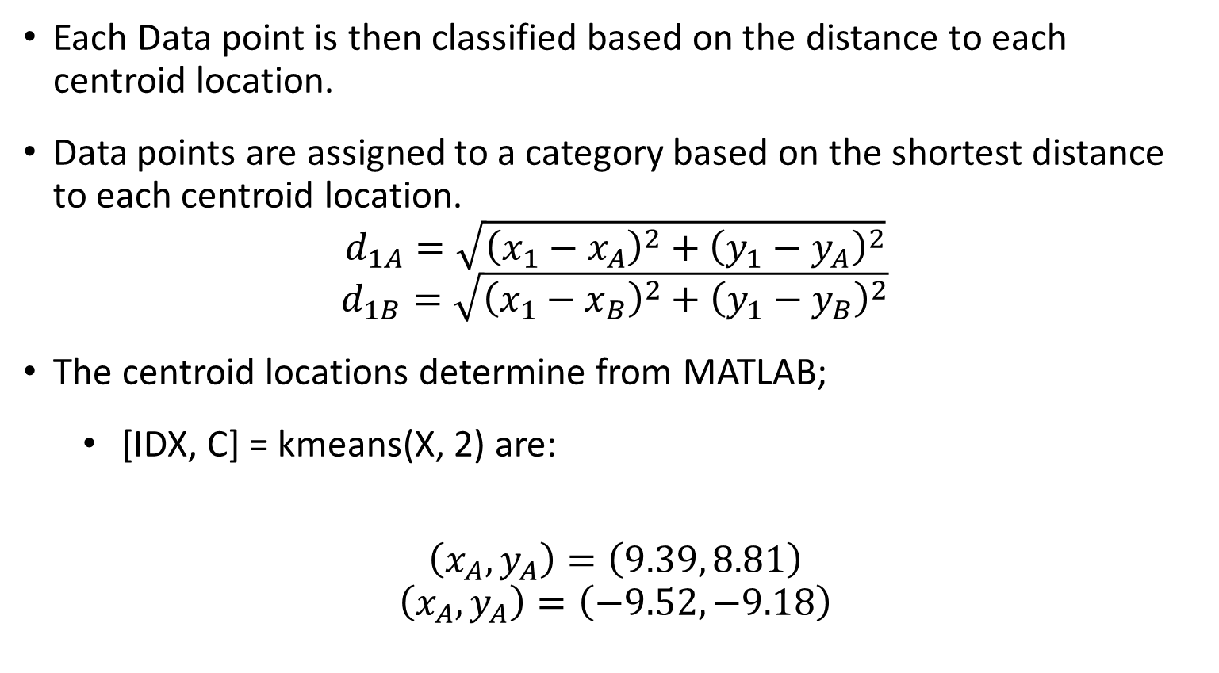
Cluster Analysis
Each Data point is then classified based on the distance to each centroid location.
Data points are assigned to a category based on the shortest distance to each centroid location.
$$d_{1A}=\sqrt{{\left(x_{1}−x_{A}\right)}^{2}+{\left(y_{1}−y_{A}\right)}^{2}}$$
$$d_{1B}=\sqrt{{\left(x_{1}−x_{B}\right)}^{2}+{\left(y_{1}−y_{B}\right)}^{2}}$$
The centroid locations determine from MATLAB;
[IDX, C] = kmeans(X, 2) are:
$$\left(x_{A}, y_{A}\right)=\left(9.39, 8.81\right)$$
$$\left(x_{A}, y_{A}\right)=\left(−9.52,−9.18\right)$$
9.3924 8.8128
-9.5240 -9.1759

Slide 43
Final Classification after Cluster Analysis

Slide 44
Sector Categorization – Cluster Analysis
You are an analyst at a Major Investment Bank.
Your PM asks to you categorize 500 stocks into appropriate categories in order to develop a well diversified and hedged portfolio.
Your PM asks you to categorize stocks based on weekly price returns over the last year.
Thus, we have 52 data observations with 500 data points. X = 52x500
We perform Cluster Analysis using MATLAB
[IDX, C] = kmeans(X, 11) are
We choose 11 categories to match the number of categories in the S&P 500 index.

Slide 45
Financial Sector Classification
[1] Classification via S&P Economic Research

Slide 46
Financial Sector Classification
[1] Classification via S&P Economic Research
[2] Classification via Cluster Analysis using MATLAB

Slide 47
Classification / Cluster Analysis

Slide 48
Limit Order Model (LOM) Prediction

Slide 49
Limit Order Model
You are an analyst at a Major Investment Bank.
You have been asked to develop a new trading algorithm using machine learning.
You need to develop a limit order models (LOM) to estimate the probability that a Buy Order will execute at the Best Market Bid.
The model you will analyze are:
Power Function
Logistic Model
Neural Network

Slide 50
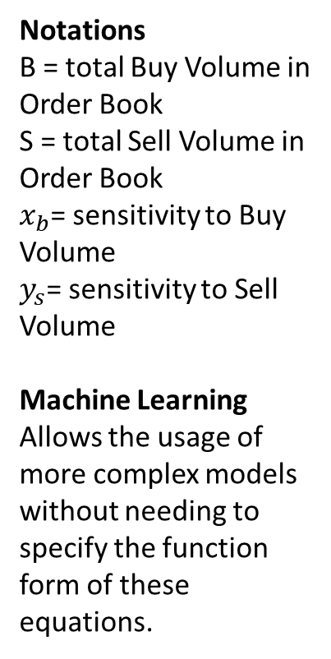
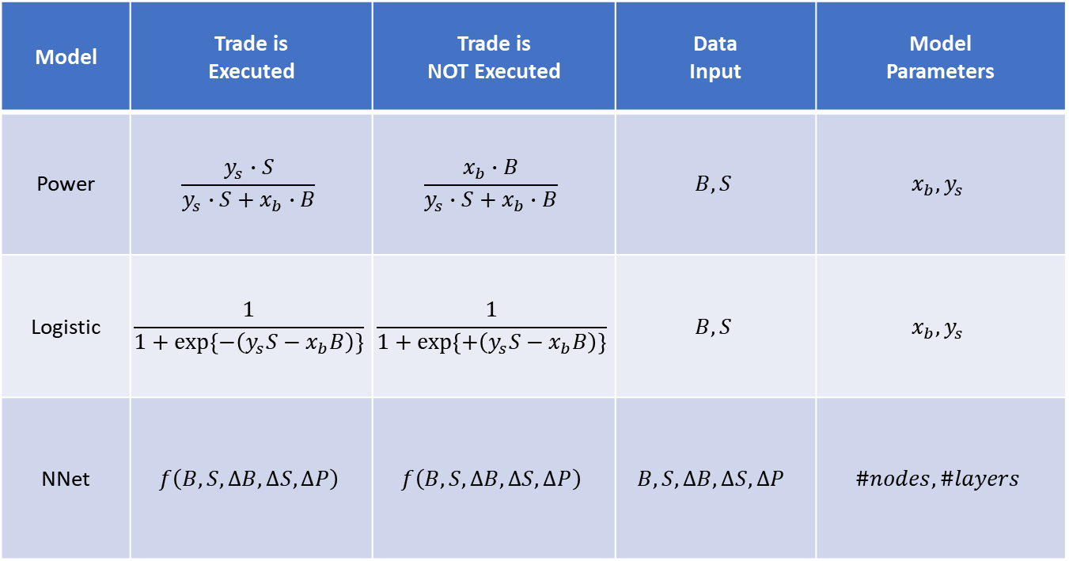
Limit Order Model – Comparison of Prediction Accuracy
Model | Trade is Executed | Trade is NOT Executed | Data Input | Model Parameters
Power | $$\frac{y_{s}∙S}{y_{s}∙S+x_{b}∙B}$$ | $$\frac{x_{b}∙B}{y_{s}∙S+x_{b}∙B}$$ | $$B, S$$ | $$x_{b}, y_{s}$$
Logistic | $$\frac{1}{1+\exp\left\{−\left(y_{s}S−x_{b}B\right)\right\}}$$ | $$\frac{1}{1+\exp\left\{+\left(y_{s}S−x_{b}B\right)\right\}}$$ | $$B, S$$ | $$x_{b}, y_{s}$$
NNet | $$f\left(B, S, ∆B, ∆S, ∆P\right)$$ | $$f\left(B, S, ∆B, ∆S, ∆P\right)$$ | $$B, S, ∆B, ∆S, ∆P$$ | $$\#nodes, \#layers$$
Notations
B = total Buy Volume in Order Book
S = total Sell Volume in Order Book
$x_{b}$= sensitivity to Buy Volume
$y_{s}$= sensitivity to Sell Volume
Machine Learning
Allows the usage of more complex models without needing to specify the function form of these equations.

Slide 51
Limit Order Model – Comparison of Prediction Accuracy

Slide 52
Limit Order Model – Model Prediction Error

Slide 53
Sports Prediction Models

